Slide 1
“Check-Before-you-Solve”: Verifiable Time-lock Puzzles
2025 S&P
Jiajun Xin, Papadopoulos
分享人：王慧

Slide 2
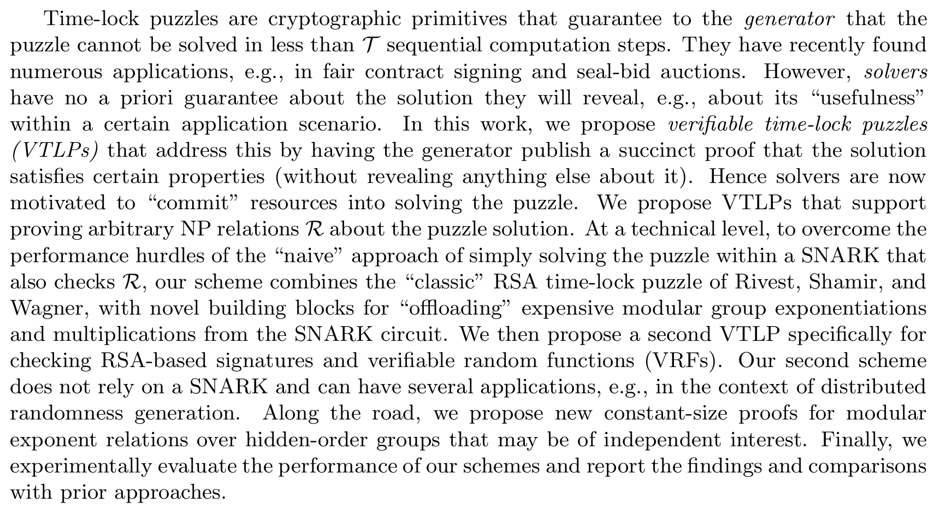
摘要

Slide 3
研究内容
引言
预备知识
模幂证明
可验证时间锁谜题
性能分析

Slide 4
研究内容
引言
预备知识
模幂证明
可验证时间锁谜题
性能分析

Slide 5
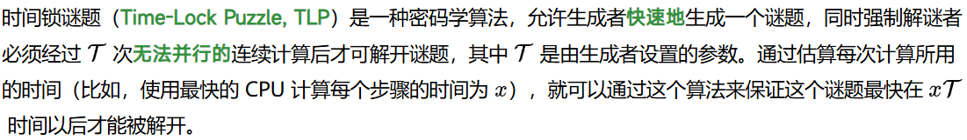
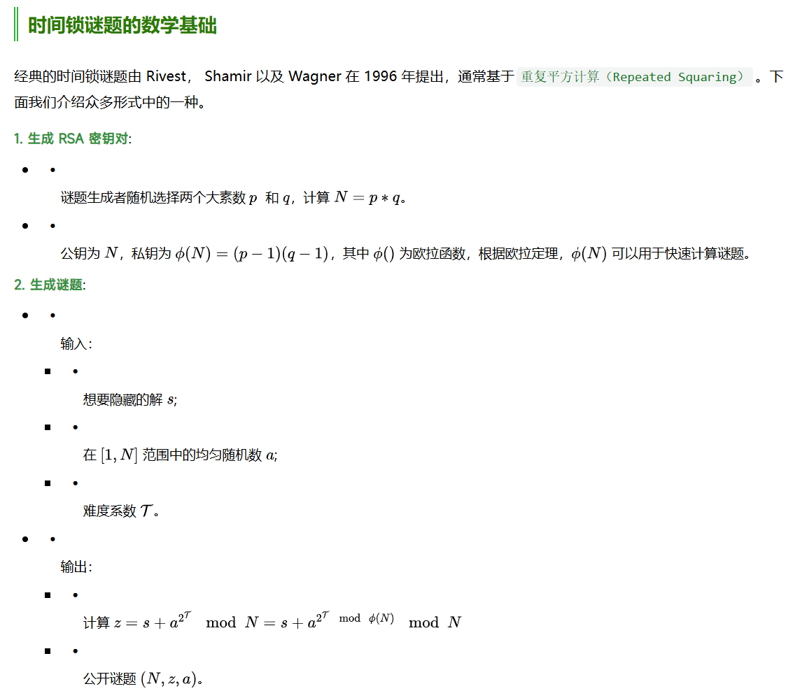
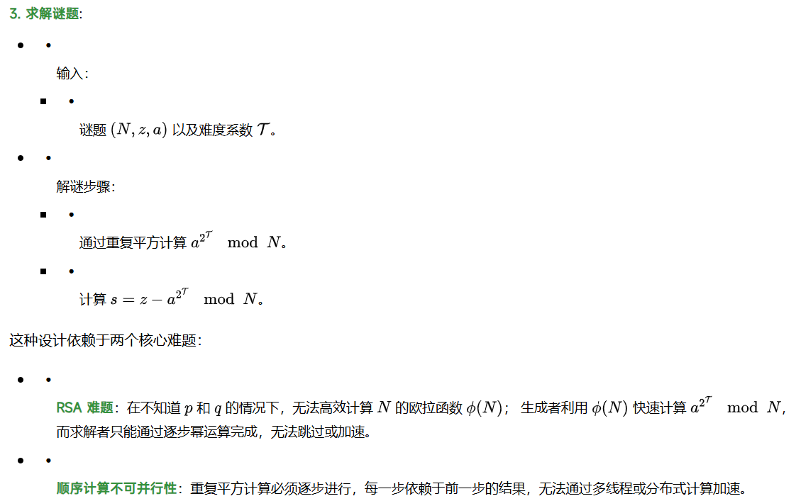
1.1时间锁谜题（TLP）概念

Slide 6
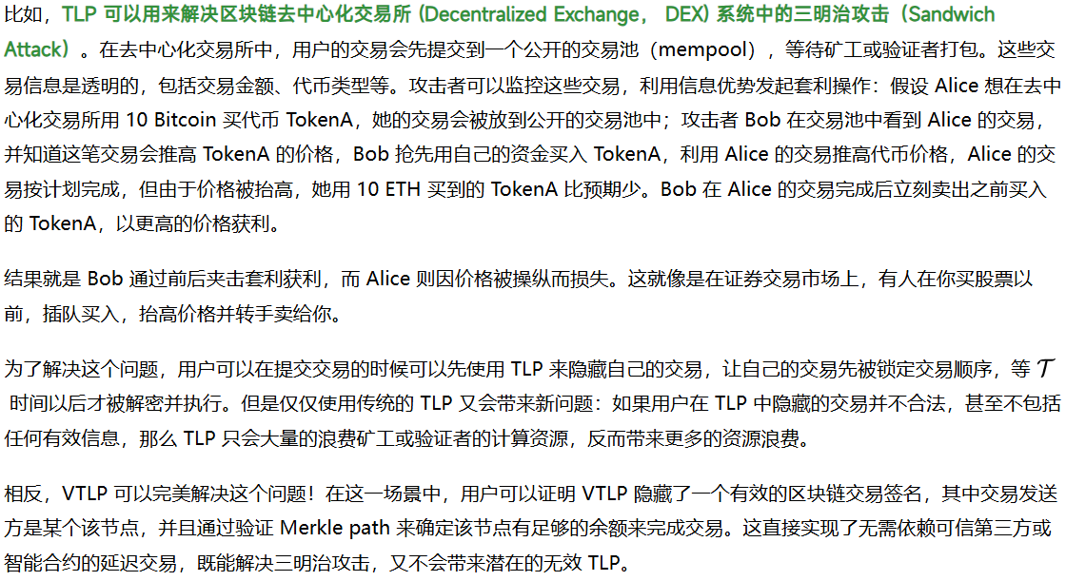
1.2 TLP应用及存在的问题

Slide 7
1.3 本文贡献
1. We propose protocols for proving different modular exponent relations in hidden order groups and use them to enable offloading product and modular exponentiation computations from a SNARK circuit.
2. We propose definitions for VTLPs for NP and the first construction that satisfies them. Our scheme has efficient proof generation, and O(1) proof size and verification cost. As a special case, it achieves very efficient verifiable time-lock signatures, for SNARK-friendly signatures, e.g., BabyJubjub, and BLS.
3. We propose a VTLP for efficient RSA signature/VRF checking, without relying on SNARKs.
4. We experimentally evaluate the performance of our constructions and compare it with prior state-of-the-art approaches.

Slide 8
研究内容
引言
预备知识
模幂证明
可验证时间锁谜题
性能分析

Slide 9
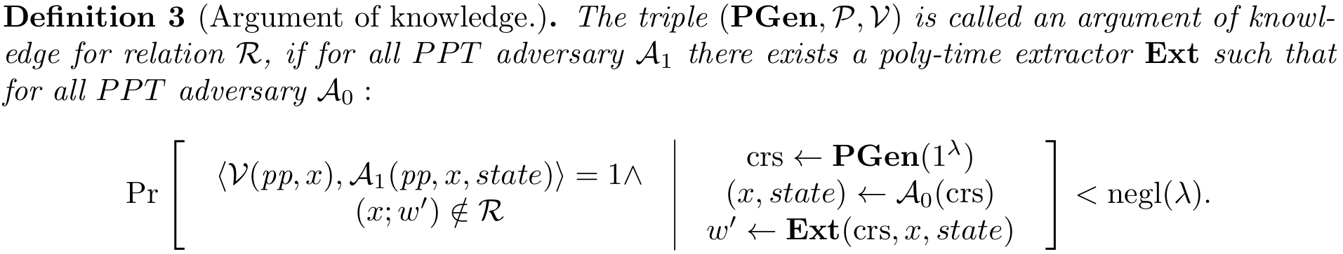
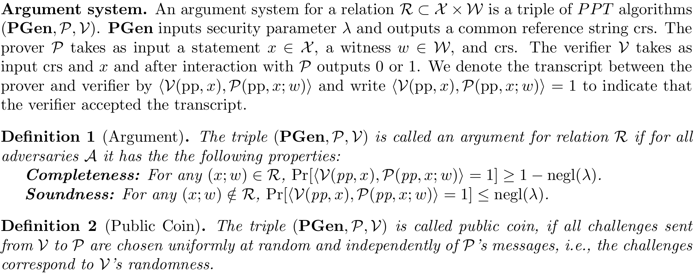
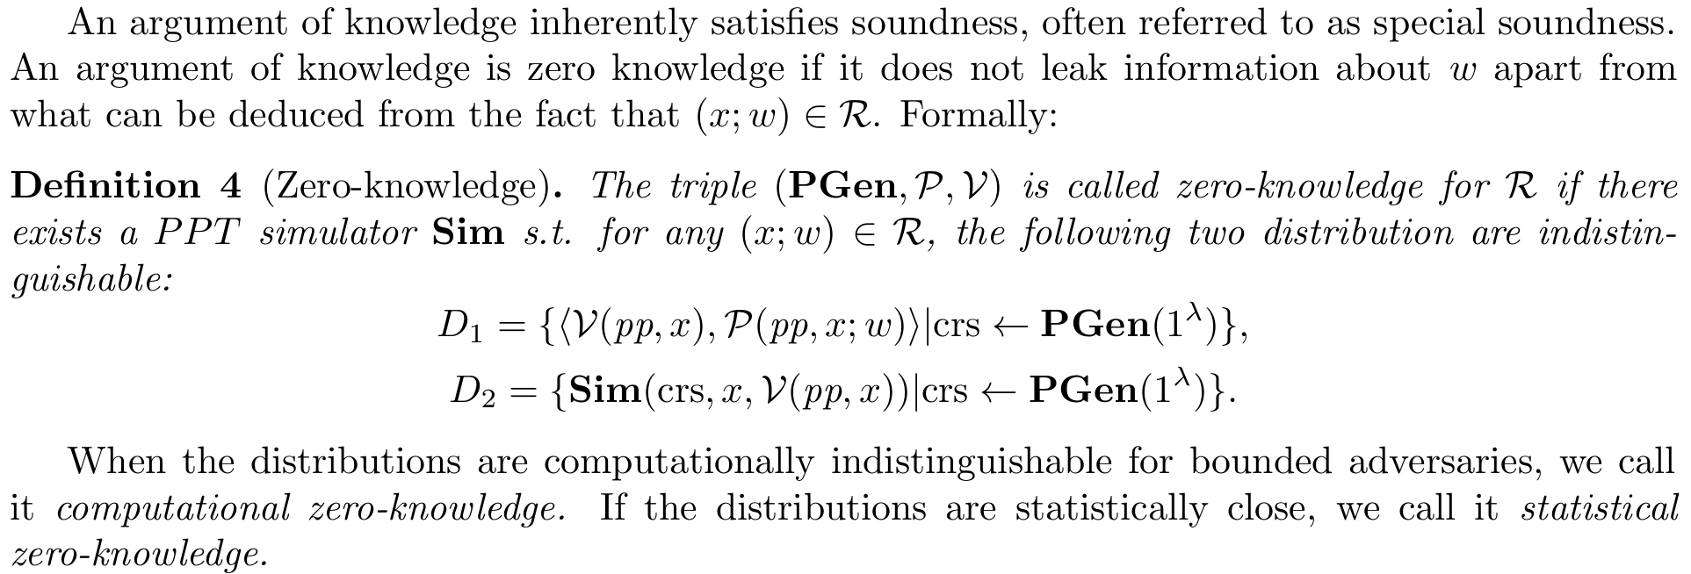
2.1 Argument

Slide 10
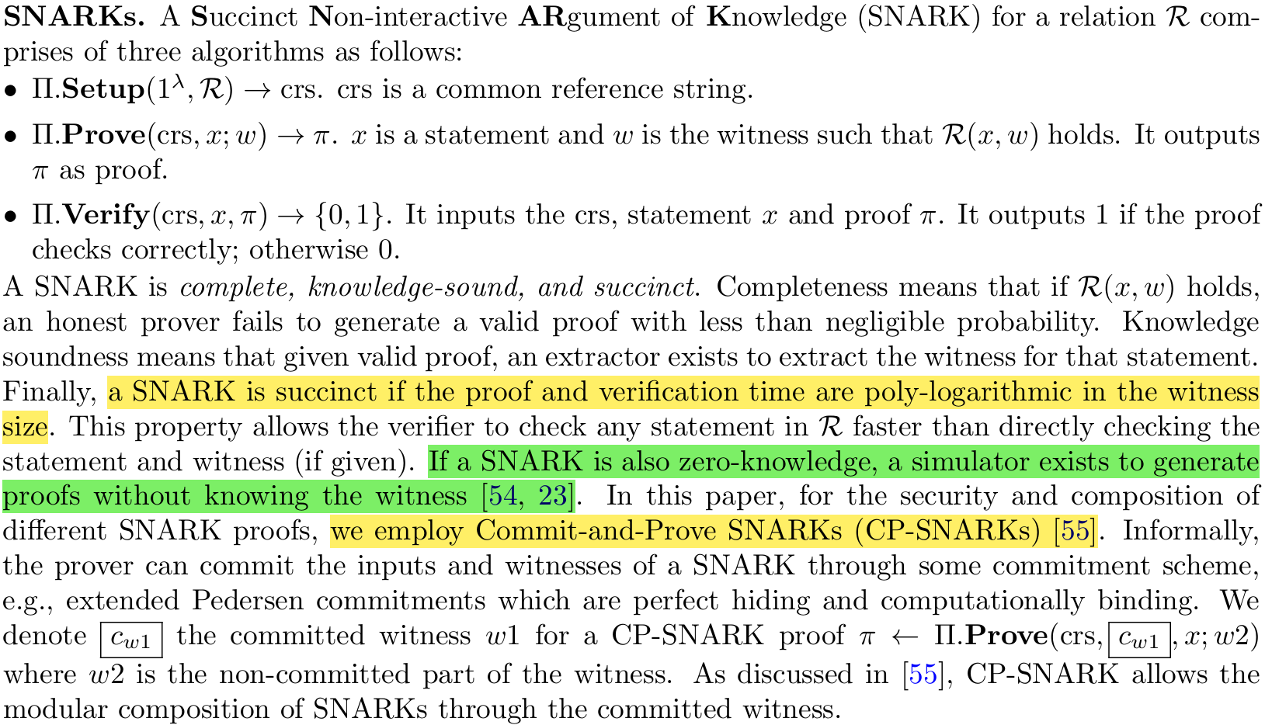
2.2 SNARKs

Slide 11
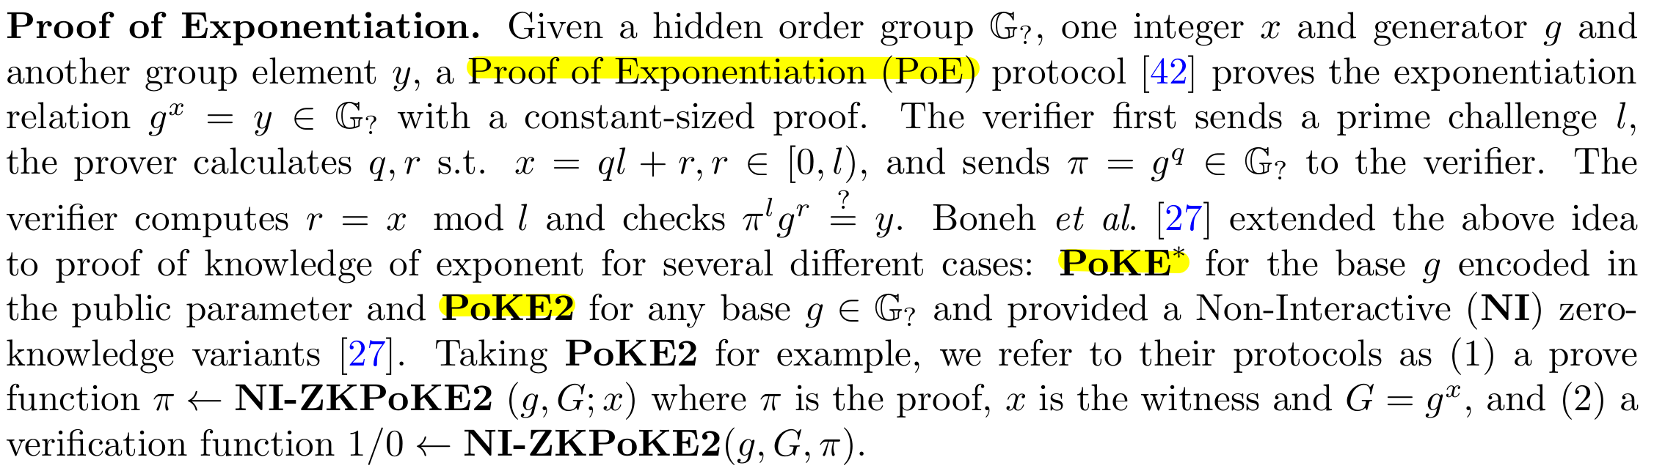
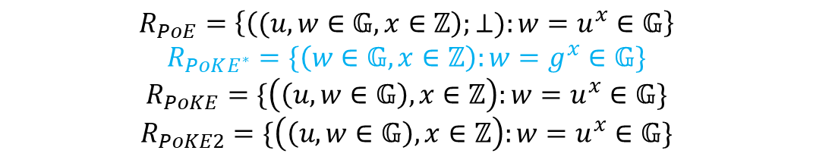



2.3 Proof of Exponentiation[27]
$$R_{PoE}=\left\{\left((u,w∈𝔾,x∈ℤ\right);⊥):w=u^{x}∈𝔾\right\}$$
$$R_{PoKE^{∗}}=\{\left(w∈𝔾,x∈ℤ\right):w=g^{x}∈𝔾\}$$
$$R_{PoKE}=\{\left(\left(u,w∈𝔾\right),x∈ℤ\right):w=u^{x}∈𝔾\}$$
$$R_{PoKE2}=\{\left(\left(u,w∈𝔾\right),x∈ℤ\right):w=u^{x}∈𝔾\}$$
$公开$验证
$隐藏$阶群
$R_{PoKE}$减少一轮交互

Slide 12
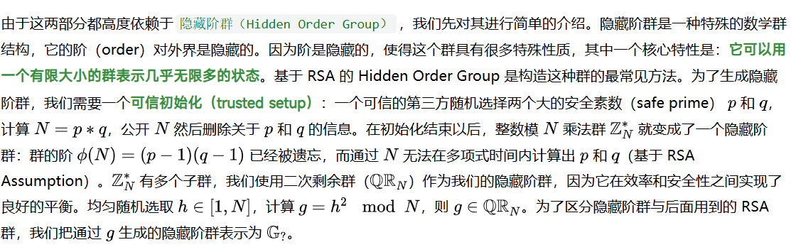

2.4 隐藏阶群
$隐藏$阶群：
阶对外界隐藏，可用有限大小的群表示几乎无限多的状态
参考链接：https://foresightnews.pro/article/detail/80143

Slide 13
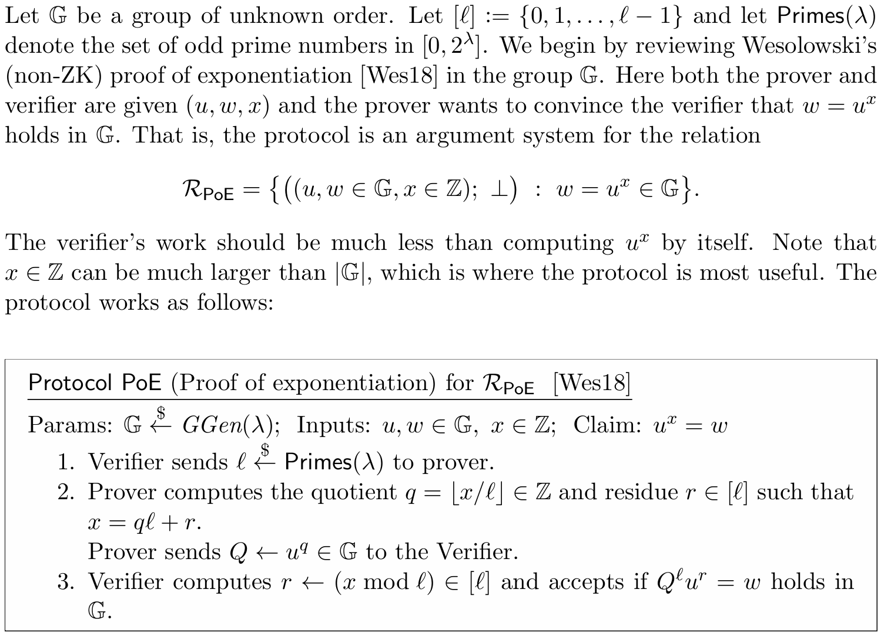
2.3 Proof of Exponentiation[27]
$$R_{PoE}=\left\{\left((u,w∈𝔾,x∈ℤ\right);⊥):w=u^{x}∈𝔾\right\}$$

Slide 14
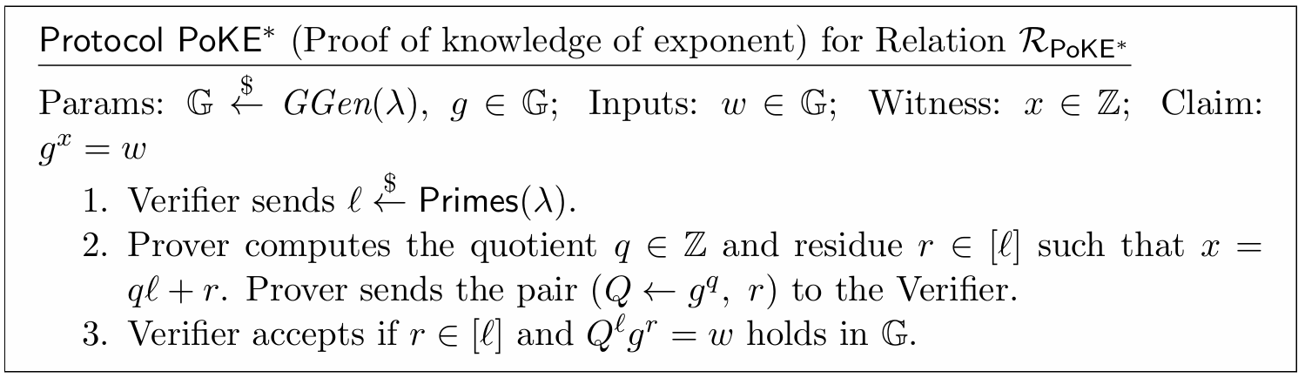
2.3 Proof of Exponentiation[27]

Slide 15
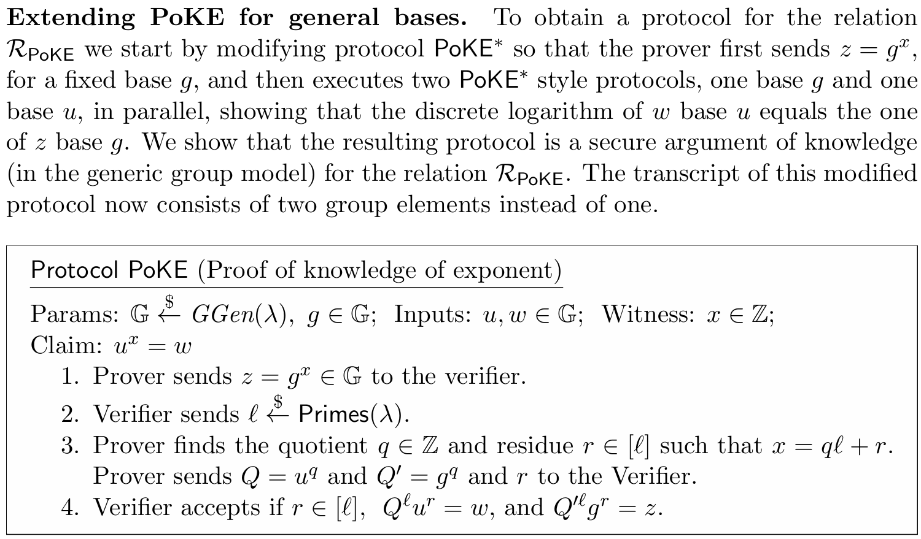
2.3 Proof of Exponentiation[27]

Slide 16
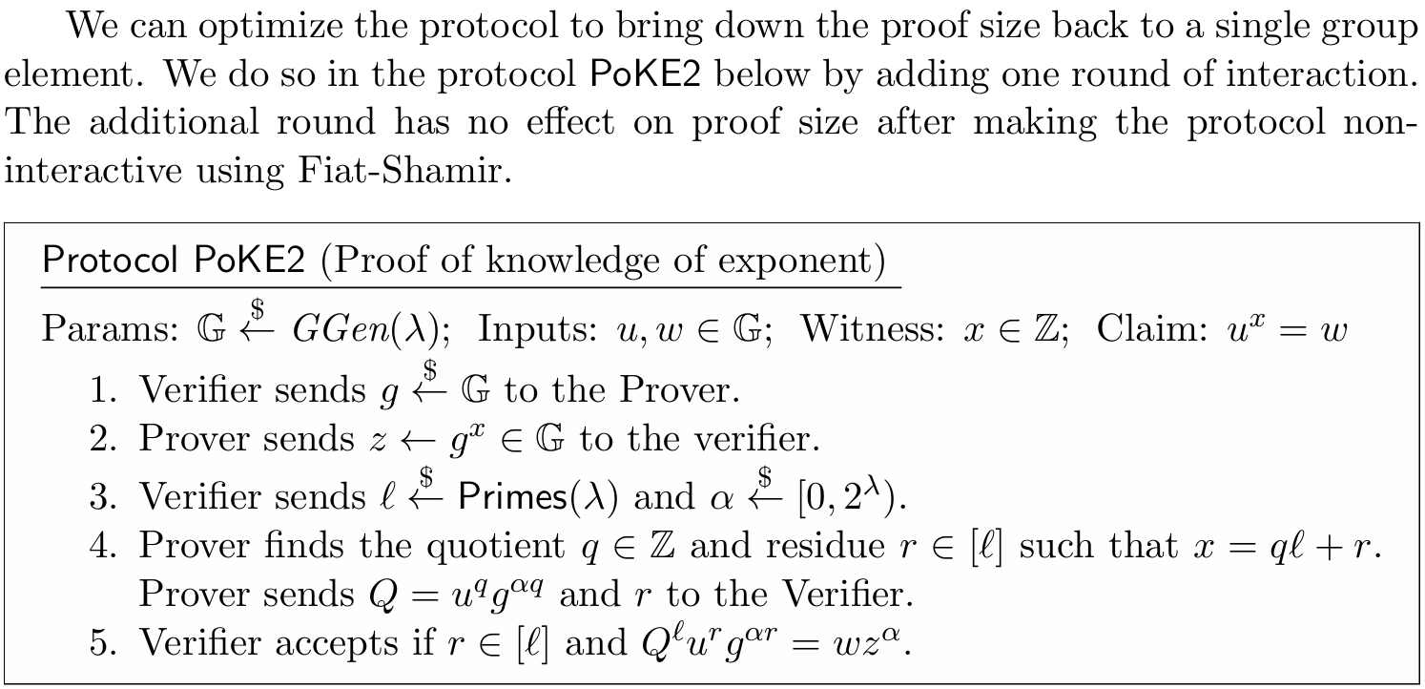
2.3 Proof of Exponentiation[27]

Slide 17
研究内容
引言
预备知识
模幂证明
可验证时间锁谜题
性能分析

Slide 18
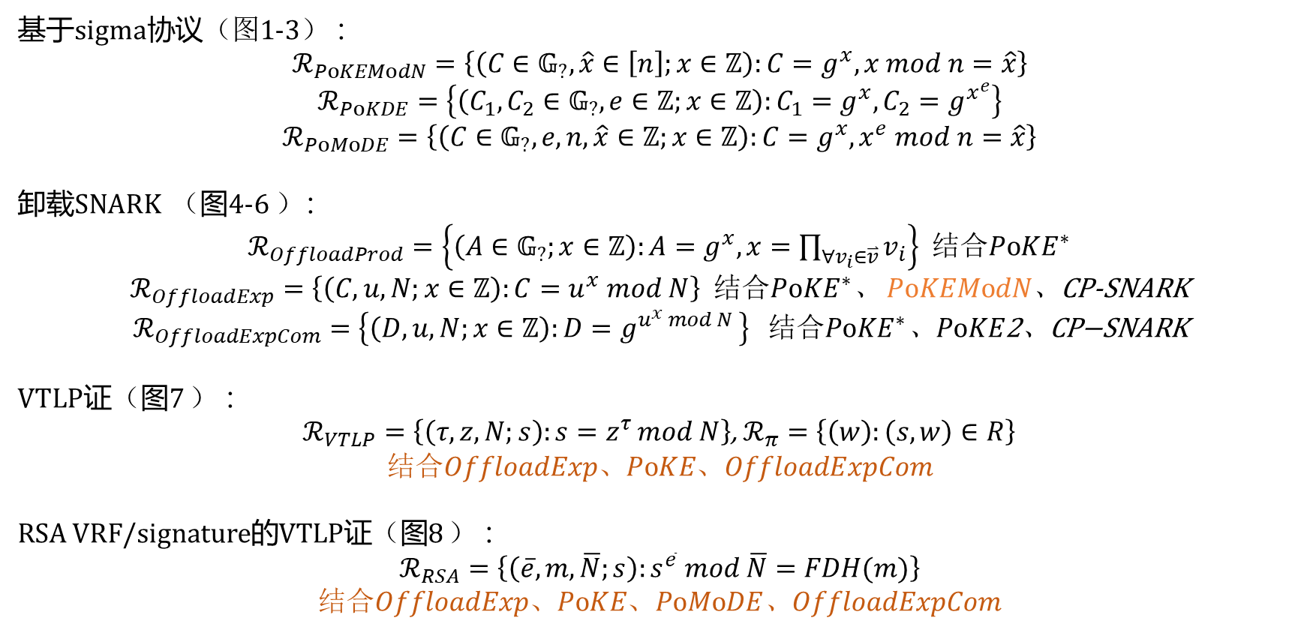
3 模幂证明概述
基于sigma协议（图1-3） ：
$$ℛ_{PoKEModN}=\left\{\left(C∈𝔾_{?},\hat{x}∈\left[n\right];x∈ℤ\right):C=g^{x}, x mod n=\hat{x}\right\}$$
$$ℛ_{PoKDE}=\left\{\left(C_{1},C_{2}∈𝔾_{?},e∈ℤ;x∈ℤ\right):C_{1}=g^{x},C_{2}=g^{x^{e}}\right\}$$
$$ℛ_{PoMoDE}=\left\{\left(C∈𝔾_{?},e,n,\hat{x}∈ℤ;x∈ℤ\right):C=g^{x}, x^{e} mod n=\hat{x}\right\}$$
卸载SNARK （图4-6 ）：
$ℛ_{OffloadProd}=\left\{\left(A∈𝔾_{?};x∈ℤ\right):A=g^{x}, x=\prod_{∀v_{i}∈\overset{⃑}{v}}{v_{i}}\right\}$ 结合$PoKE^{∗}$
$ℛ_{OffloadExp}=\left\{\left(C,u,N;x∈ℤ\right):C=u^{x} mod N\right\}$ 结合$PoKE^{∗}$、 $PoKEModN$、CP-SNARK
$$ℛ_{OffloadExpCom}=\left\{\left(D,u,N;x∈ℤ\right):D=g^{u^{x} mod N }\right\} \text{结合}PoKE^{∗}\text{、}PoKE\text{2}\text{、}\text{CP}\text{−}\text{SNARK}$$
VTLP证（图7 ） ：
$ℛ_{VTLP}=\left\{\left(τ,z,N;s\right):s=z^{τ }mod N\right\}$, $ℛ_{π}=\left\{\left(w\right):\left(s,w\right)∈R\right\}$
结合$OffloadExp、PoKE、OffloadExpCom$
RSA VRF/signature的VTLP证（图8 ） ：
$$ℛ_{RSA}=\left\{\left(\overline{e},m,\overline{N};s\right):s^{\overline{e}} mod \overline{N}=FDH(m)\right\}$$
结合$OffloadExp、PoKE、PoMoDE$、$OffloadExpCom$

Slide 19
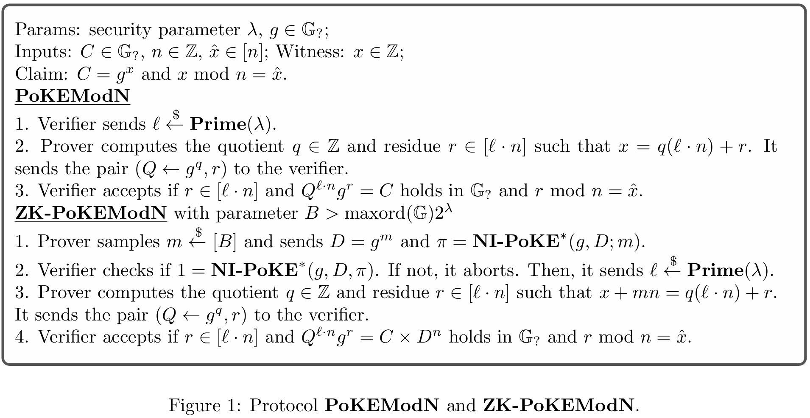
3.1 PoKEModN证明
$$ℛ_{PoKEModN}=\left\{\left(C∈𝔾_{?},\hat{x}∈\left[n\right];x∈ℤ\right):C=g^{x}, x mod n=\hat{x}\right\}$$

Slide 20
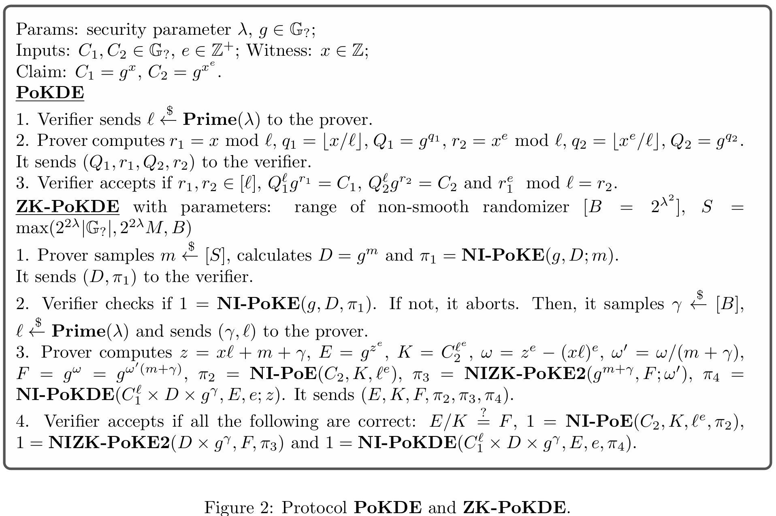
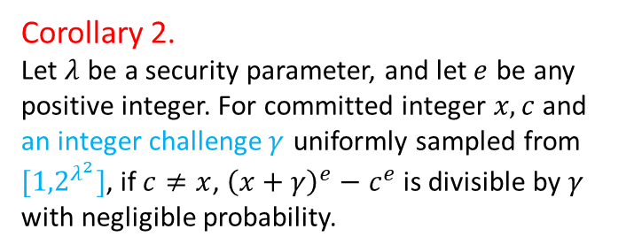
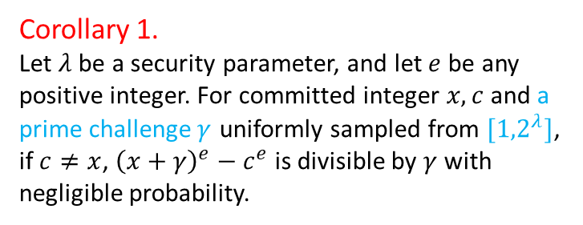
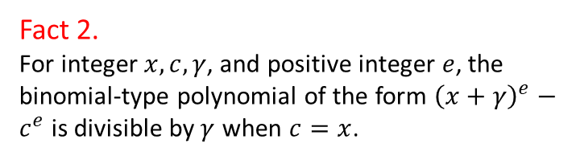
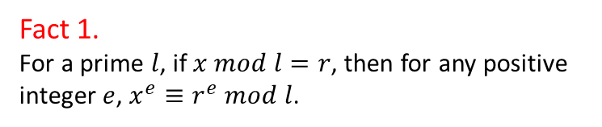
3.2 PoKDE证明
$$ℛ_{PoKDE}=\left\{\left(C_{1},C_{2}∈𝔾_{?},e∈ℤ;x∈ℤ\right):C_{1}=g^{x},C_{2}=g^{x^{e}}\right\}$$
Fact 1.
For a prime $l$, if $x mod l=r$, then for any positive integer $e$, $x^{e}≡r^{e} mod l$.
Fact 2.
For integer $x,c,γ$, and positive integer $e$, the binomial-type polynomial of the form ${\left(x+γ\right)}^{e}−c^{e}$is divisible by$γ$ when $c=x$.
Corollary 1.
Let $λ$be a security parameter, and let $e$be any positive integer. For committed integer $x,c$and a prime challenge$γ$ uniformly sampled from $[{1,2}^{λ}]$, if$c≠x$, ${\left(x+γ\right)}^{e}−c^{e}$is divisible by $γ$ with negligible probability.
Corollary 2.
Let $λ$ be a security parameter, and let$e$ be any positive integer. For committed integer $x,c$and an integer challenge$γ$ uniformly sampled from $[{1,2}^{λ^{2}}]$, if $c≠x$, ${\left(x+γ\right)}^{e}−c^{e}$is divisible by $γ$ with negligible probability.
Notes:
an integer γ is y-smooth if all its prime factors are smaller than y

Slide 21
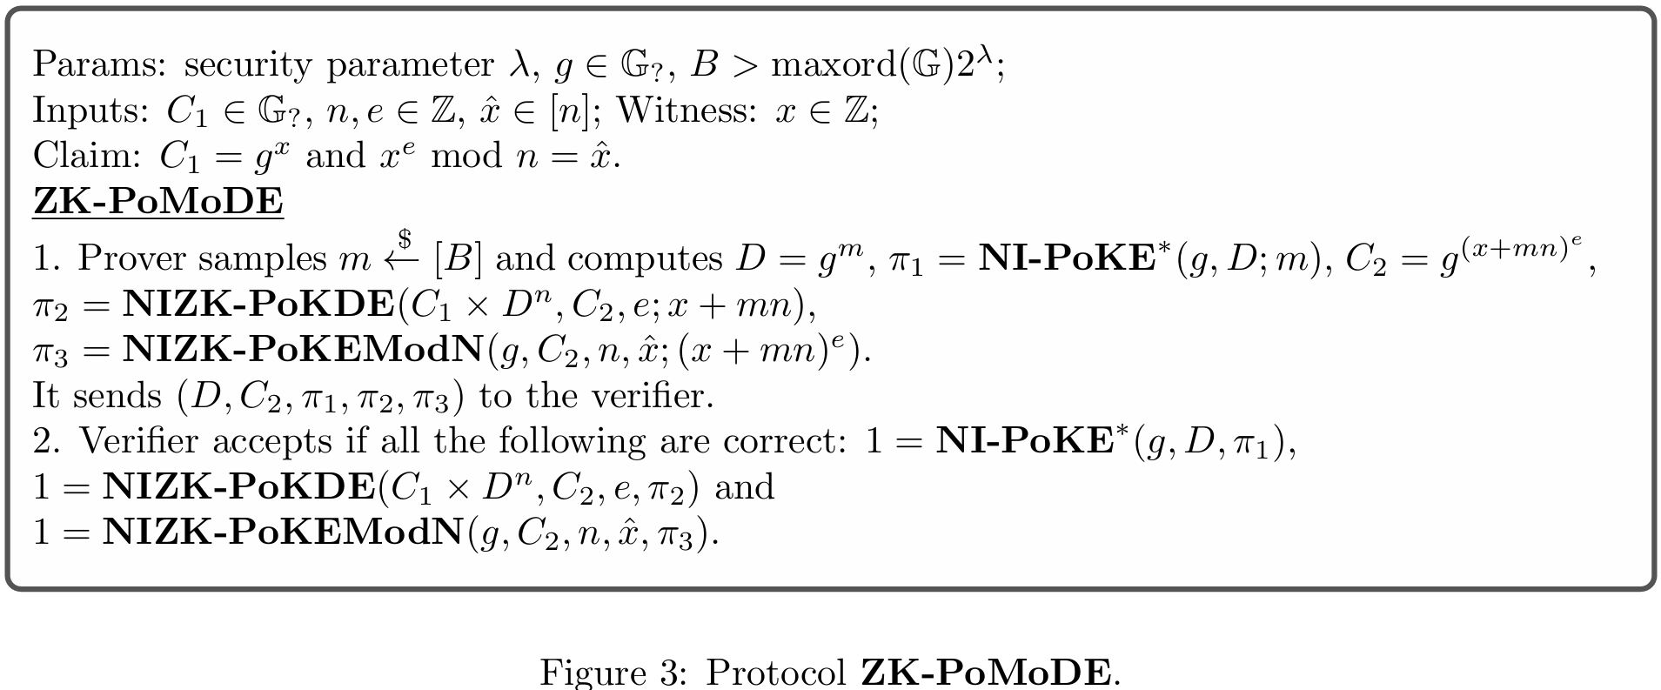
3.3 ZK-PoMoDE证明
$$ℛ_{PoMoDE}=\left\{\left(C∈𝔾_{?},e,n,\hat{x}∈ℤ;x∈ℤ\right):C=g^{x}, x^{e} mod n=\hat{x}\right\}$$
证：$C_{1}^{′}=g^{x+mn},C_{2}=g^{{(x+mn)}^{e}}$
证：$C_{2}=g^{{(x+mn)}^{e}},{(x+mn)}^{e} mod n=\hat{x}$

Slide 22
研究内容
引言
预备知识
模幂证明
可验证时间锁谜题
性能分析

Slide 23
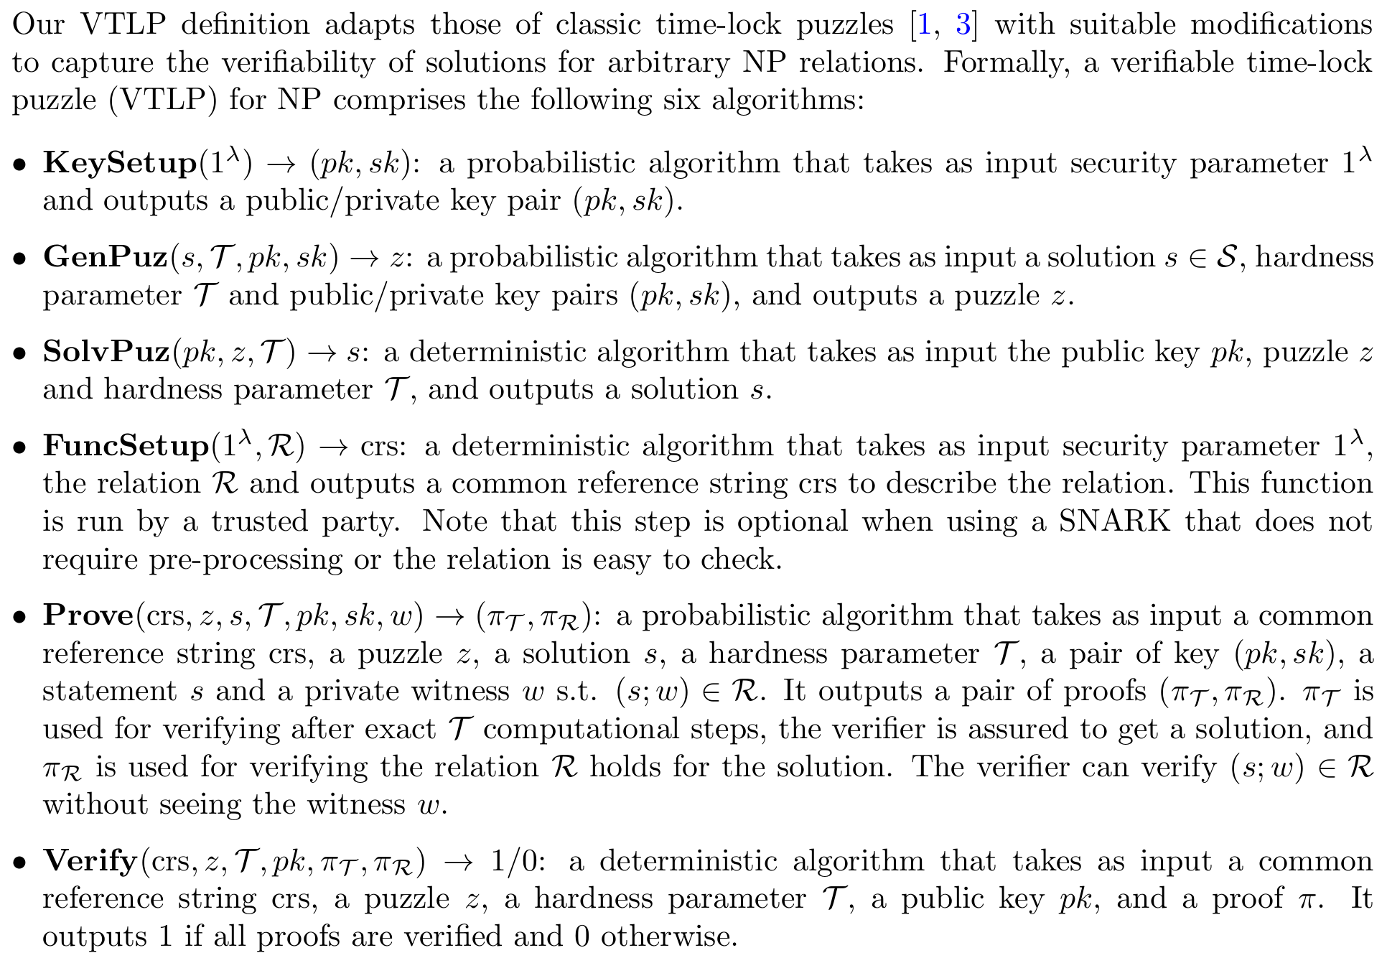
4.1 TLP定义
correctness
time-lock security
Soundness
zero-knowledge

Slide 24
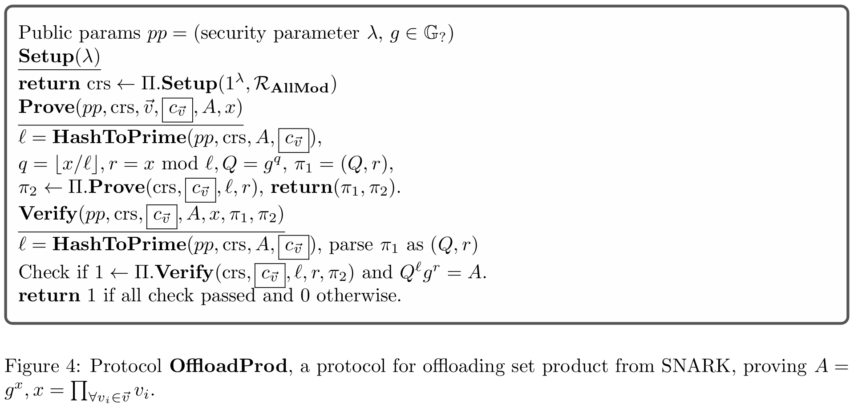
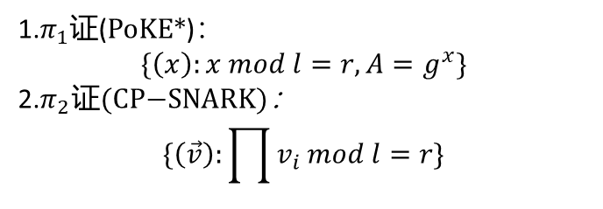
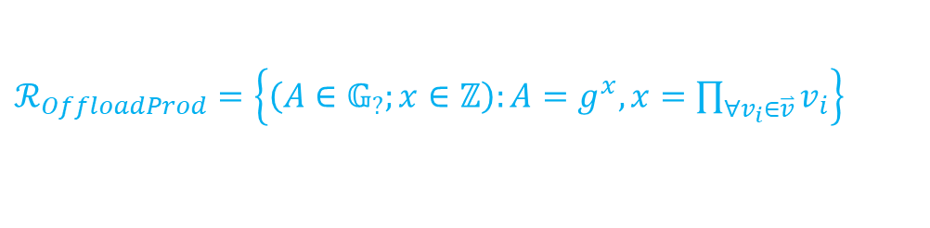
4.2 计算卸载--OffloadProd
$ℛ_{OffloadProd}=\left\{\left(A∈𝔾_{?};x∈ℤ\right):A=g^{x}, x=\prod_{∀v_{i}∈\overset{⃑}{v}}{v_{i}}\right\}$
1.$π_{1}$证(PoKE*)：
$$\{\left(x\right):x mod l=r,A=g^{x}\}$$
2.$π_{2}\text{证}\text{(}\text{CP}\text{−}\text{SNARK}\text{)}\text{：}$
$$\{\left(\vec{v}\right):\prod{v_{i}}mod l=r\}$$

Slide 25
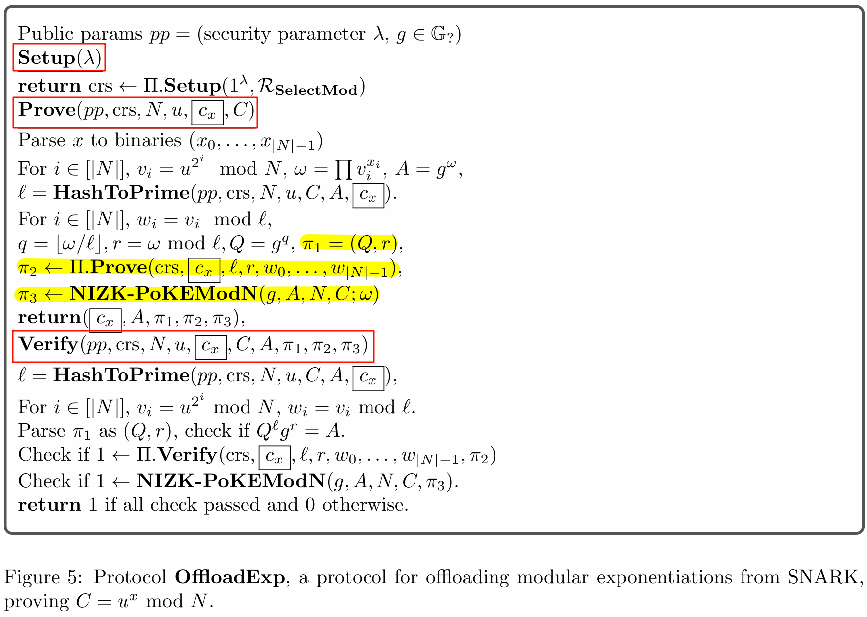
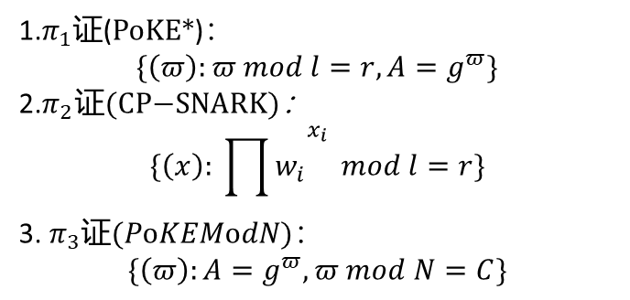
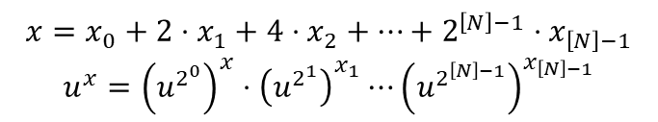
4.2 计算卸载--OffloadExp
$$ℛ_{OffloadExp}=\left\{\left(C,u,N;x∈ℤ\right):C=u^{x} mod N\right\}$$
$$x=x_{0}+2⋅x_{1}+4⋅x_{2}+⋯+2^{\left[N\right]−1}⋅x_{\left[N\right]−1}$$
$$u^{x}={\left(u^{2^{0}}\right)}^{x}⋅{\left(u^{2^{1}}\right)}^{x_{1}}⋯{\left(u^{2^{\left[N\right]−1}}\right)}^{x_{\left[N\right]−1}}$$
$$A=g^{u^{x}}$$
1.$π_{1}$证(PoKE*)：
$$\{\left(π\right):π mod l=r,A=g^{π}\}$$
2.$π_{2}\text{证}\text{(}\text{CP}\text{−}\text{SNARK}\text{)}\text{：}$
$$\{\left(x\right): {\prod{w_{i}}}^{x_{i}} mod l=r\}$$
3. $π_{3}\text{证}(PoKEModN\text{)}\text{：}$
$$\{\left(π\right):A=g^{π},π mod N=C\}$$

Slide 26
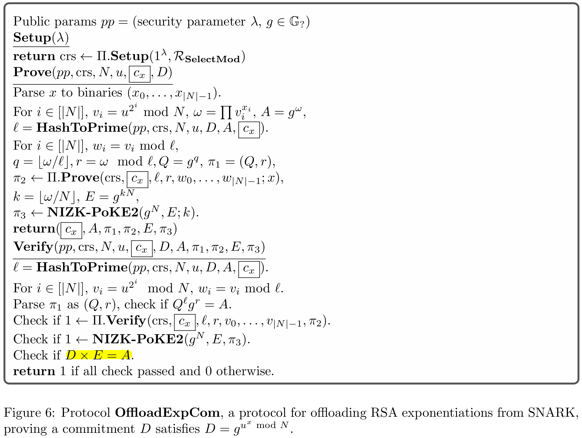
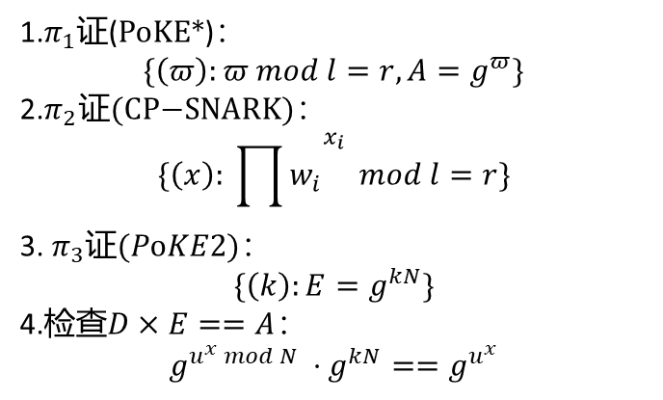
4.2 计算卸载--OffloadExpCom
$$ℛ_{OffloadExpCom}=\left\{\left(D,u,N;x∈ℤ\right):D=g^{u^{x} mod N }\right\}$$
1.$π_{1}$证(PoKE*)：
$$\{\left(π\right):π mod l=r,A=g^{π}\}$$
2.$π_{2}\text{证}\text{(}\text{CP}\text{−}\text{SNARK}\text{)}\text{：}$
$$\{\left(x\right): {\prod{w_{i}}}^{x_{i}} mod l=r\}$$
3. $π_{3}\text{证}(PoKE\text{2)}\text{：}$
$$\{\left(k\right):E=g^{kN}\}$$
4.检查$D×E==A$：
$$g^{u^{x} mod N }⋅g^{kN}==g^{u^{x}}$$

Slide 27
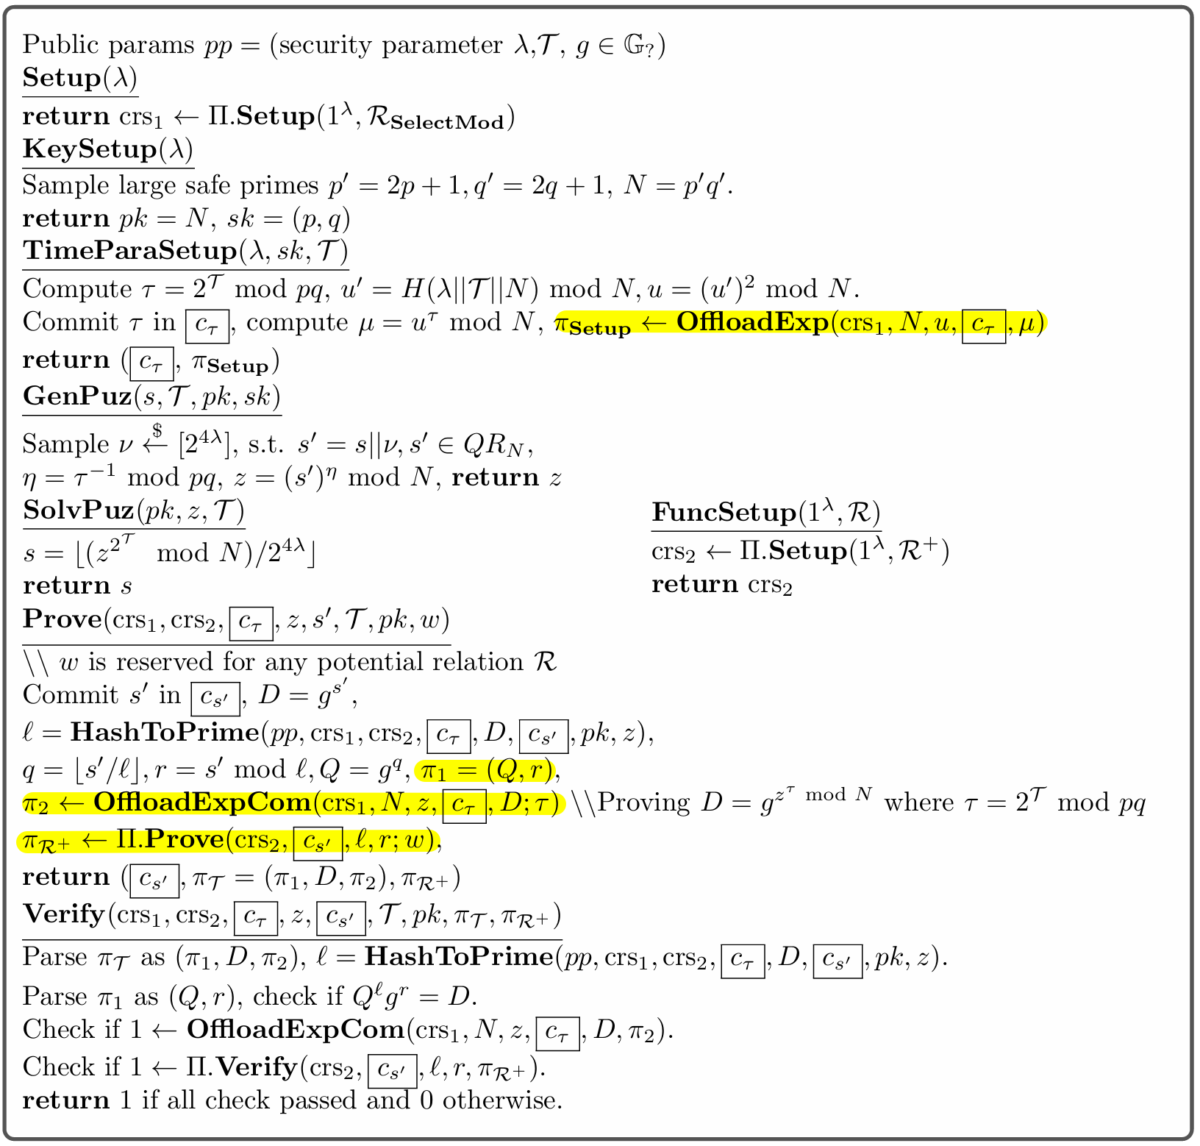
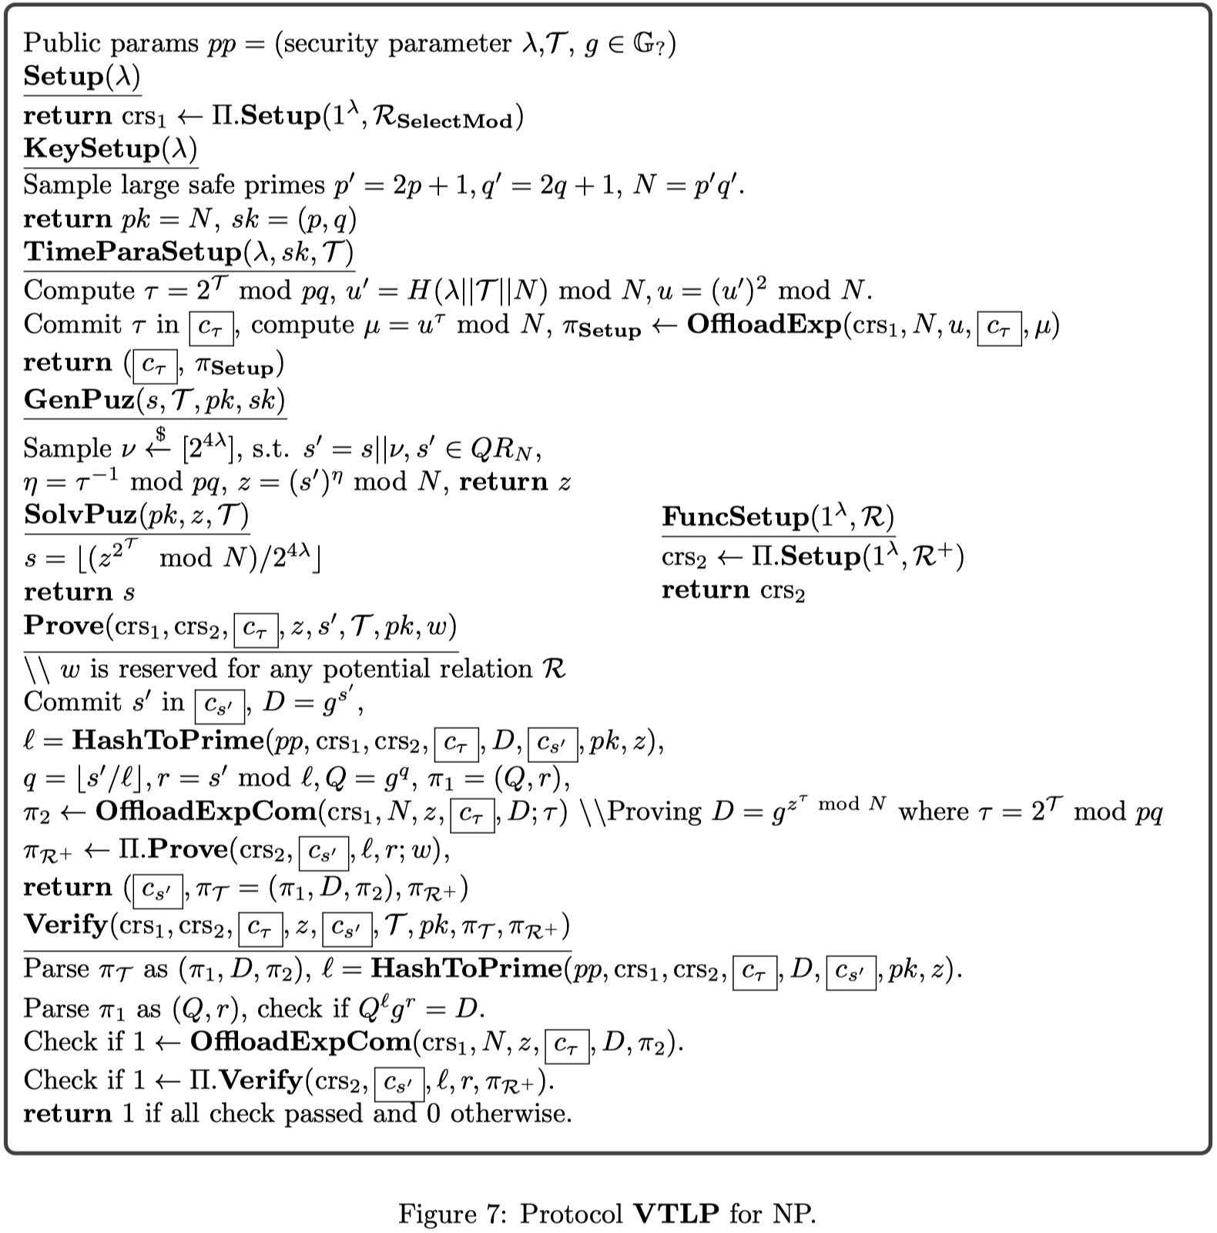
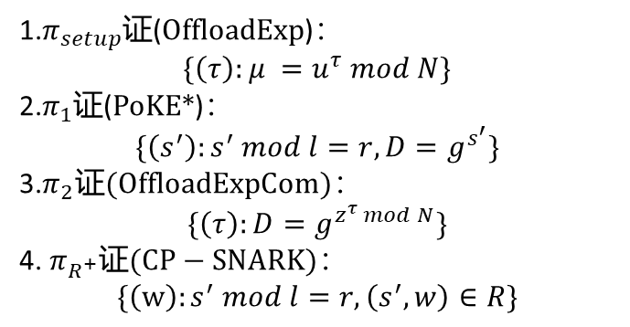
4.3 任意NP关系R的VTLP
$ℛ_{VTLP}=\left\{\left(τ,z,N;s^{′}\right):s^{′}=z^{τ }mod N\right\}$, $ℛ_{π}=\left\{\left(w\right):\left(s,w\right)∈R\right\}$
1.$π_{setup}$证(OffloadExp)：
$$\{\left(τ\right):μ =u^{τ} mod N\}$$
2.$π_{1}$证(PoKE*)：
$$\{\left(s^{′}\right):s^{′} mod l=r,D=g^{s^{′}}\}$$
3.$π_{2}\text{证}\text{(}\text{OffloadExpCom}\text{)}$：
$$\{\left(τ\right):D=g^{z^{τ} mod N}\}$$
4. $π_{R^{+}}\text{证}(CP−SNARK\text{)}\text{：}$
$$\{\left(w\right):s^{′} mod l=r,\left(s^{′},w\right)∈R\}$$

Slide 28
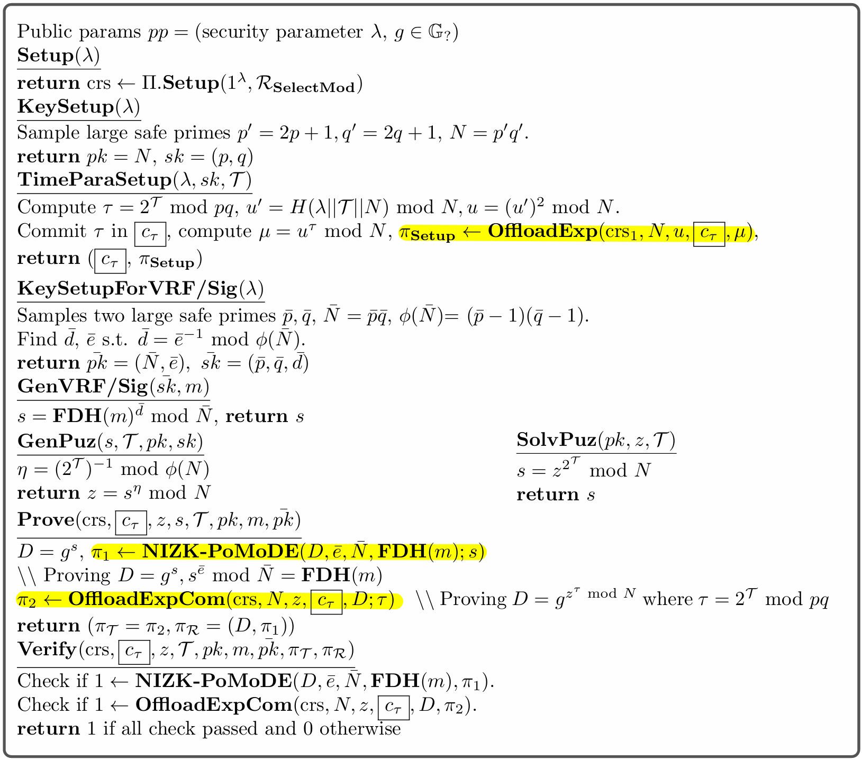
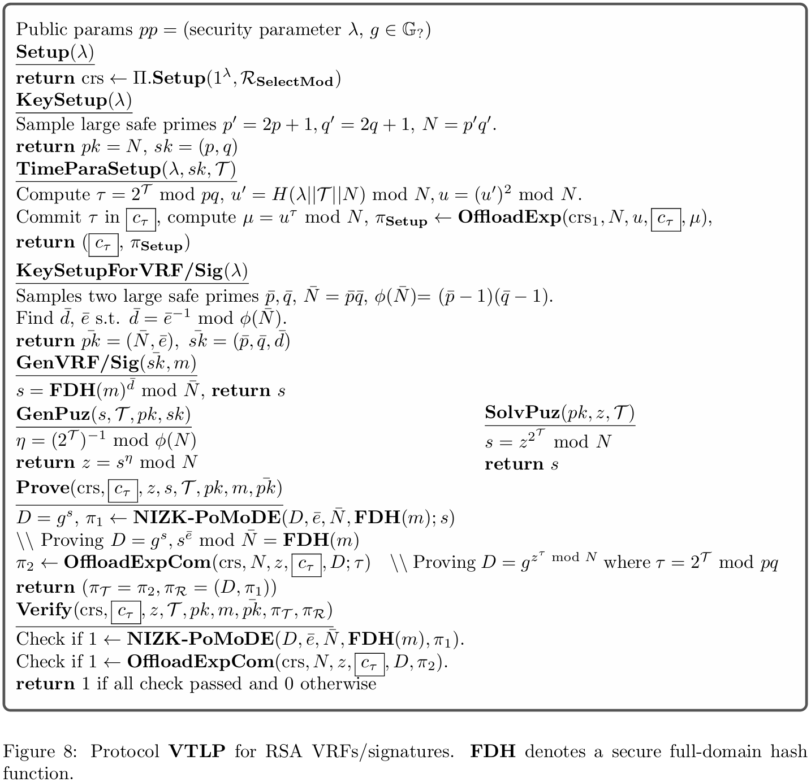
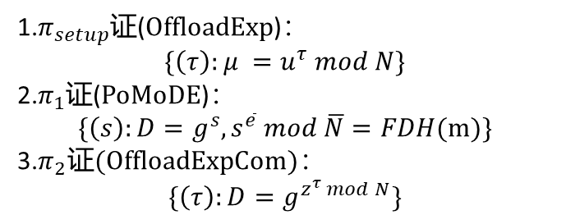
4.4 RSA VRF/签名的可验证时间锁
$$ℛ_{rsa}=\left\{\left(\overline{e},m,\overline{N};s\right):s^{\overline{e}} mod \overline{N}=FDH(m)\right\}$$
1.$π_{setup}$证(OffloadExp)：
$$\{\left(τ\right):μ =u^{τ} mod N\}$$
2.$π_{1}$证(PoMoDE)：
$$\{\left(s\right):D=g^{s},s^{\overline{e}} mod \overline{N}=FDH(m)\}$$
3.$π_{2}\text{证}\text{(}\text{OffloadExpCom}\text{)}$：
$$\{\left(τ\right):D=g^{z^{τ} mod N}\}$$

Slide 29
研究内容
引言
预备知识
模幂证明
可验证时间锁谜题
性能分析

Slide 30
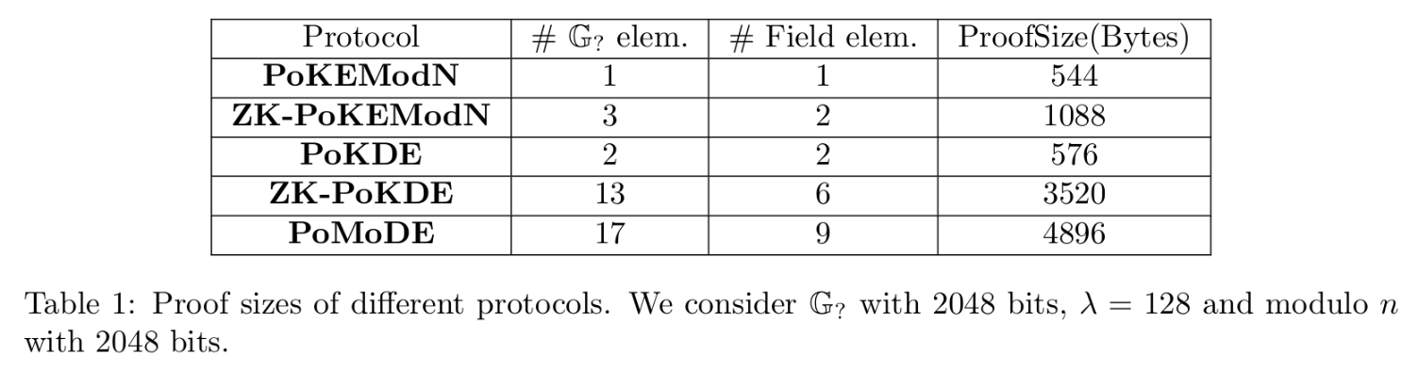
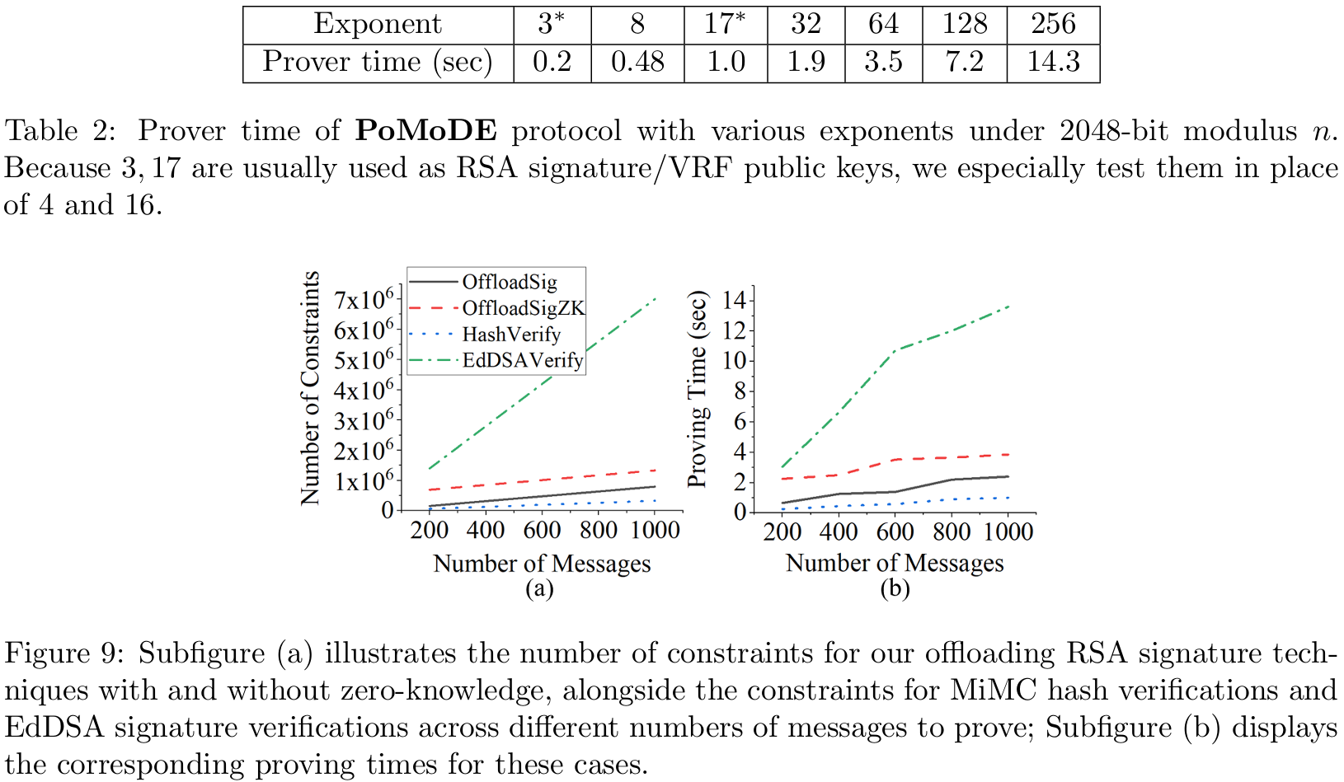
5.1 性能分析

Slide 31
5.1 性能分析

